Slide 1

Milestone 4 - Data modelling
November 15th, 2019

Slide 2
Our Team
ITI Solutions
Aidan C. - Team leader
Harley L. - Liaison officer
Justin A. - Database developer
Beryon C. - Server engineer/UX
Evan G. - Programmer/UX
Notes:
Everyone

Slide 3

Our client
Organization that provides services for people that require special assistance
Government funded/ privately funded organization
Notes:
Aidan

Slide 4
Current system
Edenbridge's current system is paper based with Excel spreadsheets and accounting software
This system has them entering & manipulating 200+ employees' timesheets manually
Notes:
Aidan

Slide 5
Project description
We are making a scheduling and time-tracking web application for Edenbridge.
Employees will be able to log in through an online portal for different options
Coordinators will be able to schedule workers, workers will be able to view their schedules
Notes:
Aidan

Slide 6
Project description
2 interconnected parts:
Time tracking
Scheduling
System will also be able to generate files that can be exported
Notes:
Aidan

Slide 7
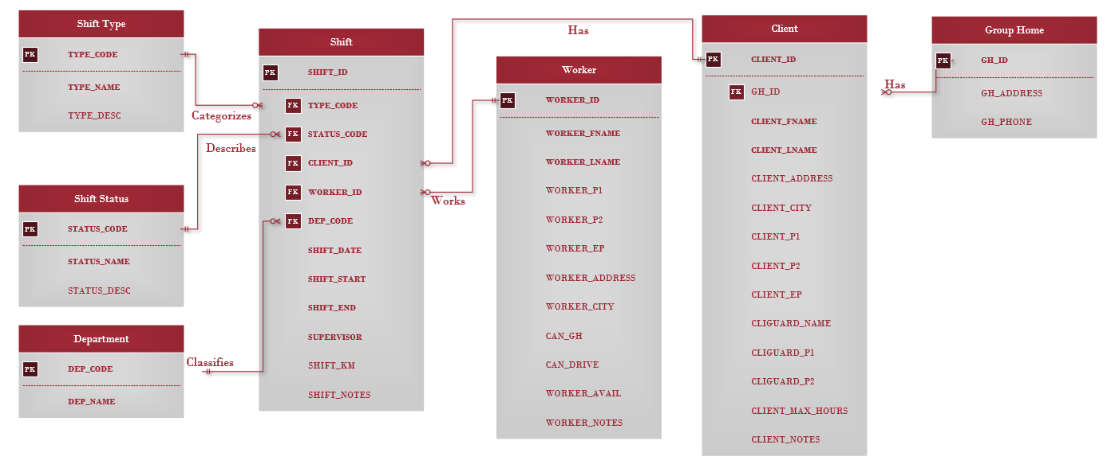
Entity Relationships

Slide 8
Field name | Field size | Data type | Data Format | Description | Example
SHIFT_ID | 20 | INT | ----------------------------- | Id number used to uniquely identify a shift. | 1234
TYPE_CODE | 3 | VARCHAR | ----------------------------- | Code used to uniquely identify the type of shift. | GHD
CLIENT_ID | 20 | INT | ----------------------------- | Id number used to uniquely identify a client. | 1234
WORKER_ID | 20 | INT | ----------------------------- | Id number used to uniquely identify a worker. | 1234
DEPT_CODE | 3 | VARCHAR | ----------------------------- | Code used to uniquely identify a department. | PRI
GH_ID | 20 | INT | ----------------------------- | Id number used to uniquely identify a group home. | 1234
STATUS_CODE | 3 | VARCHAR | ----------------------------- | Code used to uniquely identify the status of a shift. | C
SHIFT_DATE | 9 | DATE | YYYY-MM-DD | The date of a shift. | 1975-10-10
SHIFT_START | 8 | TIME | HH:MM:SS | The time of day a shift starts. | 00:24:24
SHIFT_END | 8 | TIME | HH:MM:SS | The time of day a shift ends. | 00:24:24
SUPERVISOR | 1 | BOOLEAN | N | Boolean variable showing if there is a supervisor or not. | 0
SHIFT_NOTES | 150 | LONGTEXT | ----------------------------- | Any extra information necessary for the person working the shift. | Some specific thing to take into consideration.
WORKER_LNAME | 20 | VARCHAR | ----------------------------- | The last name of a worker. | Smith
WORKER_FNAME | 20 | VARCHAR | ----------------------------- | The first name of a worker. | Jane
WORKER_ADDRESS | 40 | VARCHAR | ----------------------------- | A workers address. | 1234 Street St.
WORKER_CITY | 20 | VARCHAR | ---------------------------- | The settlement a worker lives in. | Settleville
WORKER_P1 | 20 | VARCHAR | N-NNN-NNN-NNNN | Primary phone number of a worker. | 1-123-123-1234
WORKER_P2 | 20 | VARCHAR | N-NNN-NNN-NNNN | Secondary phone number of a worker. | 1-123-123-1234
WORKER_EP | 20 | VARCHAR | N-NNN-NNN-NNNN | Emergency phone number of a worker. | 1-123-123-1234
Notes:
Harley

Slide 9
Field name | Field size | Data type | Data Format | Description | Example
CAN_GH | 1 | BOOLEAN | N | Whether a worker can work in a group home or not. | 1
WORKER_NOTES | 150 | LONGTEXT | ---------------------------- | Any extra information about the worker. | Some specific thing to take into consideration.
CLIENT_LNAME | 20 | VARCHAR | ---------------------------- | The first name of a client. | Picard
CLIENT_FNAME | 20 | VARCHAR | ---------------------------- | The last name of a client. | William
CLIENT_ADDRESS | 40 | VARCHAR | ---------------------------- | The address of a client. | 1234 Street St.
CLIENT_CITY | 20 | VARCHAR | N-NNN-NNN-NNNN | The settlement a client lives in. | 1-123-123-1234
CLIENT_P1 | 14 | VARCHAR | N-NNN-NNN-NNNN | Primary phone number of a client. | 1-123-123-1234
CLIENT_P2 | 14 | VARCHAR | N-NNN-NNN-NNNN | Secondary phone number of a client. | 1-123-123-1234
CLIENT_EP | 14 | VARCHAR | N-NNN-NNN-NNNN | Emergency phone number of a client. | 1-123-123-1234
CLIGUARD_NAME | 20 | VARCHAR | ------------------------------ | Name of a client’s guardian. | Jean
CLIGUARD_P1 | 14 | VARCHAR | N-NNN-NNN-NNNN | Primary phone number of a client’s guardian. | 1-123-123-1234
CLIGUARD_P2 | 14 | VARCHAR | N-NNN-NNN-NNNN | Secondary phone number of a client’s guardian. | 1-123-123-1234
GROUP_HOME | 1 | BOOLEAN | N | A boolean describing whether a client belongs to a group home or not. | 0
MAX_PER_MONTH | 4 | FLOAT | NN.NN | Maximum amount of hours that can be allocated to client. | 56.75
CLIENT_NOTES | 150 | LONGTEXT | --------------------------- | Any extra information about the client. | Some specific thing to take into consideration.
GH_ADDRESS | 40 | VARCHAR | --------------------------- | The address of a group home. | 1234 Street St.
GH_PHONE | 14 | VARCHAR | N-NNN-NNN-NNNN | The phone number of a group home. | 1-123-123-1234
STATUS_NAME | 20 | VARCHAR | --------------------------- | Name of a shift’s status. | Pending
DEPT_NAME | 20 | VARCHAR | --------------------------- | Name of a department. | Private
Notes:
Harley

Slide 10
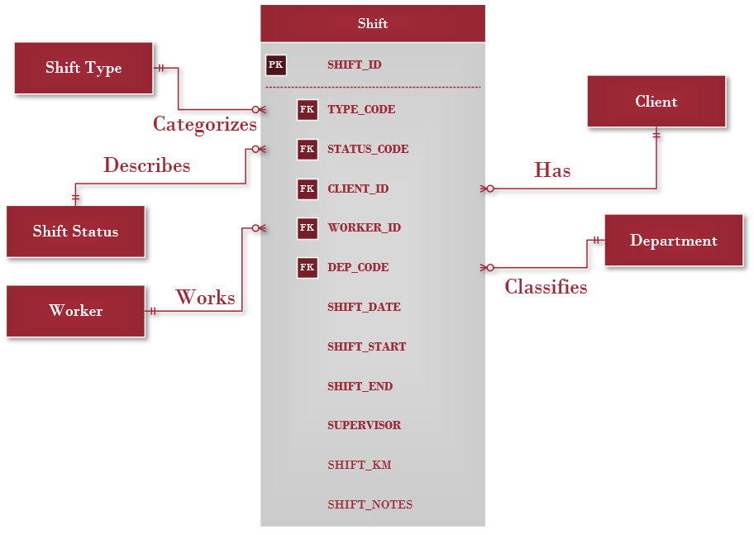
Shift Table
Notes:
Evan

Slide 11
Shift Table – Rules and Data
SHIFT_ID | TYPE_CODE | CLIENT_ID | WORKER_ID | DEPT_CODE | STATUS_CODE | SHIFT_DATE
1 | GHD | 25 | 3 | GH | C | 12/11/2019
2 | INT | 52 | 87 | PDO | S | 1/3/2020
SHIFT_START | SHIFT_END | SUPERVISOR | SHIFT_NOTES | SHIFT_KM
13:00 | 18:00 | 1 | Notes go here | 23
8:00 | 12:00 | 0 | Notes go here | 40
Many shifts can be for one client
Many shifts can be worked by one worker
Many shifts can be categorized by one shift type
Many shifts can by classified into one department
Many shifts can be described by one shift status

Slide 12
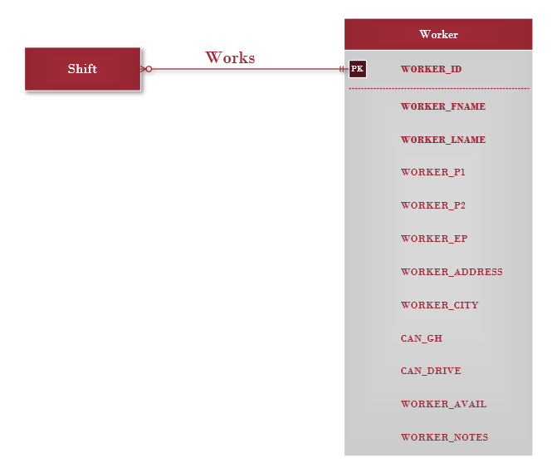
Worker table

Slide 13
Worker table – Rules and Data
WORKER_ID | WORKER_FNAME | WORKER_LNAME | WORKER_ADDRESS | WORKER_CITY | WORKER_P1
1 | Bob | Smith | 123 Some St. | Lethbridge | Xxx-xxx-xxxx
2 | Jim | Halpert | 456 Another St. | Lethbridge | Xxx-xxx-xxxx
WORKER_P2 | WORKER_EP | CAN_GH | CAN_DRIVE | WORKER_AVAIL | WORKER_NOTES
Xxx-xxx-xxxx | Xxx-xxx-xxxx | 1 | 1 | Wed,8:00-23:00; | Notes go here
Xxx-xxx-xxxx | Xxx-xxx-xxxx | 0 | 1 | Tus,4:00-20:00; | Notes go here
One worker can work many shifts
One shift is worked by one worker

Slide 14
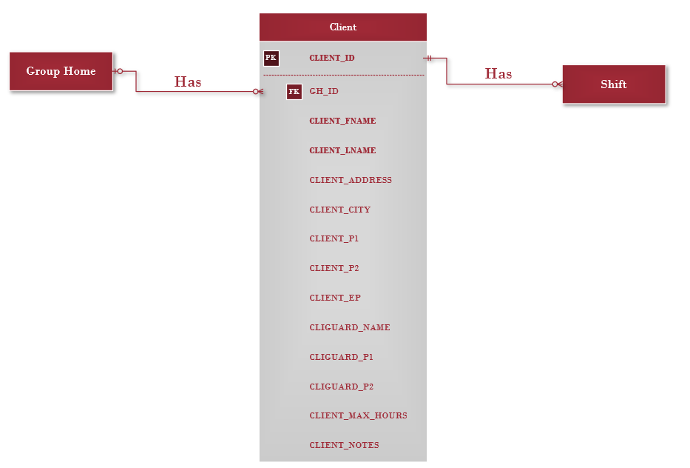
Client table

Slide 15
Client table – Rules and Data
CLIENT_ID | CLIENT_ FNAME | CLIENT_ LNAME | CLIENT_ADDRESS | CLIENT_CITY | CLIENT_P1 | CLIENT_P2
1 | Clarkson | Jeremy | 123 Sample St. | Lethbridge | Xxx-xxx-xxxx | Xxx-xxx-xxxx
2 | McDonald | Jessie | 456 another St. | Lethbridge | Xxx-xxx-xxxx | Xxx-xxx-xxxx
CLIENT_EP | CLIGUARD_ NAME | CLIGUARD_ P1 | CLIGUARD_ P2 | CLIENT_NOTES | CLIENT_ KM | GH_ID | CLIENT_MAX_ HOURS
Xxx-xxx-xxxx | Tom | Xxx-xxx-xxxx | Xxx-xxx-xxxx |  | 5 | 1 | 20
Xxx-xxx-xxxx | Jorge | Xxx-xxx-xxxx | Xxx-xxx-xxxx |  | 10 | 0 | 15
One client can have many shifts
One shift is for one client
Many clients can live in one group home
One client lives in one group home

Slide 16
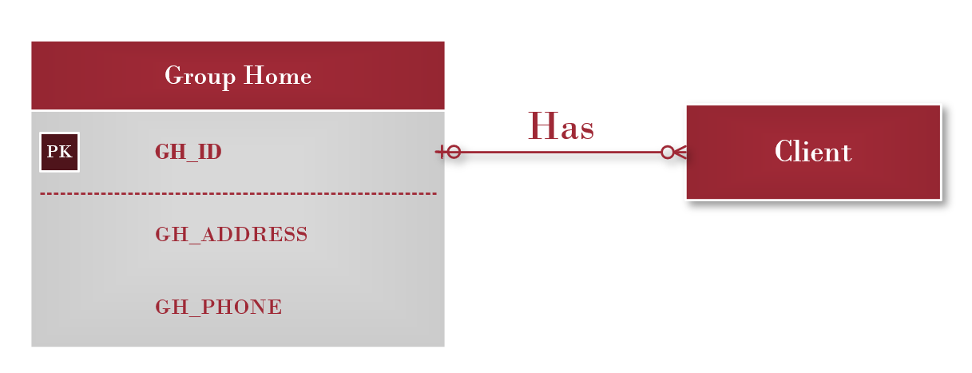
Group home table
Notes:
Justin

Slide 17
Group home table – Rules and Data
GH_ID | GH_ADDRESS | GH_PHONE
1 | 123 Some St. | Xxx-xxx-xxxx
2 | 456 Another St. | Xxx-xxx-xxxx
One group home can have many clients
One client can live in one group home
Notes:
Justin

Slide 18
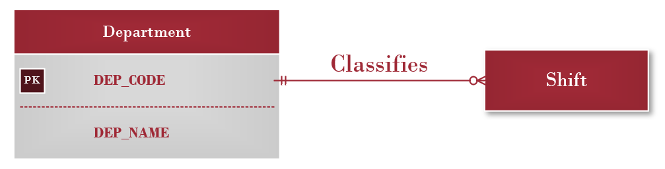
Department table
Notes:
Justin

Slide 19
Department table – Rules and Data
DEPT_CODE | DEPT_NAME
PDO | PDO
CAP | Capp-C
PRI | Private
One department can classify many shifts
One shift can be classified into one department
Notes:
Justin

Slide 20
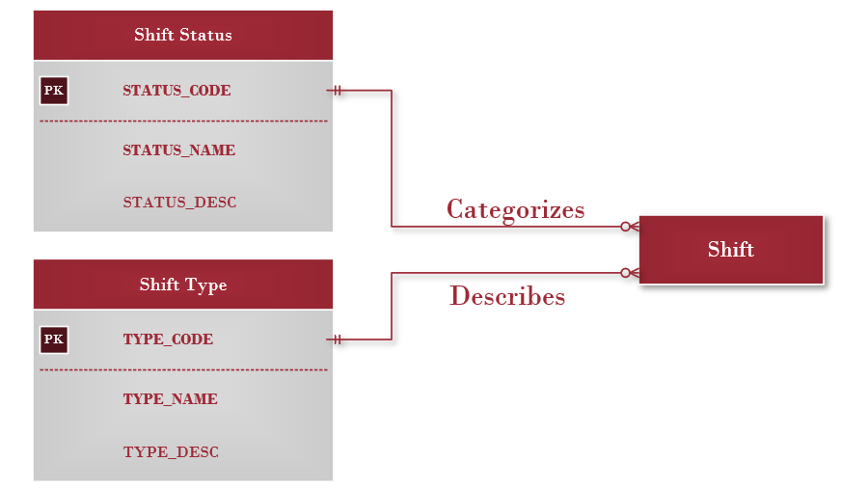
shift status & type tables
Notes:
Justin

Slide 21
shift status & type tables – Rules and Data
TYPE_CODE | TYPE_NAME | TYPE_DESC
GHD | Group Home - day | Group home awake
GHN | Group Home - night | Group home asleep
INT | In town | Client is in town
STATUS_CODE | STATUS_NAME
C | Completed
S | Signed
A | Approved
One shift type categorizes many shifts
One shift status can describe many shifts
One shift is described by one shift status
One shift is categorized by one shift type
Notes:
Justin

Slide 22
Conclusion
Tables to be used allow for a strong degree of adjustment and much increased utilization.
Optional fields can be used as Edenbridge adjusts further with the new system.
Notes:
Beryon
Touch on the adaptability of the tables. Only the essential fields required to calculate pay and schedules will be mandatory. As Edenbridge looks to expand the utilization of the new system, more fields can be used which will open up more options within software for calculations and UI.

Slide 23
Looking Forwards
In the next month:
Detailed feasibility analysis
System proposal w/ recommendations
Next 3 months:
Designing of UI
Final design of infrastructure
Begin Implementation phase
Notes:
Beryon
System proposal including:
- Budget
- Timeline

Slide 24
Questions?

